Slide 1
Maintaining State
Greater Success with Greater Breadth of Awareness

Slide 2
Spring MVC Model
ALL [.NET, STRUTS, JSF] component based MVCs
Manage the model
  Gather, convert and validate request parameters
  Developer focuses on application/business function
  Model contains POJO objects that reflect state of app
  SPRING MVC uses Model interface instead of HTTP Objects
Goal of Spring MVC framework
  As view-agnostic as possible - not bound to the HTTP
public interface Model
  Defines a holder for model attributes.
  Allows for accessing the overall model as a java.util.Map.

Slide 3
JavaBean vs POJO vs Spring Bean
JavaBean
  Adhere to Sun’s JavaBeans specification
  Implements Serializable interface
  Must have default constructor, setters&getters
  Reusable Java classes for visual application composition
POJO
  ‘Fancy’ way to describe ordinary Java Objects
  Doesn’t require a framework
  Doesn’t require an application server environment
  Simpler, lightweight compared to ‘heavyweight’ EJBs
Spring Bean
  Spring managed - configured, instantiated and injected
A Java object can be a JavaBean, a POJO and a Spring bean all at the same time.
Notes:
JavaBeans They are serializable, have a zero-argument constructor, and allow access to properties using getter and setter methods.

Slide 4
Model Scoped Attributes
JSP page scope
  The page scope restricts the scope and lifetime of attributes to the same page where it was created.
Request scope
  only be available for that request
  Thread Safe
Session Scope
  Session is defined by set of session scoped attributes
  Lifetime is a browser session
  Sessions are a critical state management service provided by the web container.
Context scope
  Application level state
  Lifetime is “usually” defined by deployment of application
  Attributes available to every controller and request in the application

Slide 5
Managing state information
How to handle the different scopes of model information:
Request scope: short term computed results to pass from one servlet to another (i.e., “forward”)
  request.setAtttribute(key,value)
  model.addAttribute(key,value)
Session scope: conversational state info across a series of sequential requests from a particular user
  HttpSession session = request.getSession(); session.setAttribute(key,value);
  @SessionAttributes - model.addAttribute(key,value)
Application/context scope: global info available to all controllers in this application
  request.getServletContext().getAttribute("appName")
  OR
  @Autowired
  ServletContext servletContext;
  servletContext.getAttribute("appName")

Slide 6
Request Scope Attribute
@RequestMapping(value = "/forward")
public String forward(Product product, Model model) {
  product.setDescription("Request Attribute Exists!!");
  model.addAttribute("requestAttribute", product);
  model.addAttribute("redirectParamTest", "Request Parameter EXISTS!");
  return "forward:/get_forward";
}
@RequestMapping(value = "/get_forward")
public String getForward(Model model) {
return "ForwardRedirect";
}
ForwardRedirect.jsp
<h4>${redirectParamTest}</h4>
<h4>${requestAttribute.description}</h4>
Demo: ProductSessionExample – Forward

Slide 7
@SessionAttributes
Class level annotation that indicates an object is to be added/retrieved from Session.
@Controller
@SessionAttributes({ "Leonardo", "Splinter" })
public class SessionController {
  @RequestMapping(value = { "/getSession" }, method = RequestMethod.GET)
  public String inputProduct(Model model, HttpSession session) {
    Product product = new Product();
    product.setName("Leonardo Turtle");
    model.addAttribute("Leonardo", product);
    model.addAttribute("Splinter", "Splinter");
    // add Regular attribute
    session.setAttribute("Donatello", "Donatello Turtle");
    return "SessionForm";
  }
}
Retrieve from Model
Product product = (Product) model.asMap().get("Leonardo");
Used to mark a session attribute as not needed after the request has been processed by the controller
status.setComplete();
See demo: ProductSessionExample - Session
Notes:
If session attributes don’t exist, just null.
Spring’s @SessionAttributes is used on a controller to designate which model attributes should be stored in the session. Actually, to be precise, the Spring documentation states that the @SessionAttributes annotation “list the names of model attributes which should be transparently stored in the session or some conversational storage.” Again, the “some conversational storage” suggests how Spring MVC tries to remain technology agnostic it is design.
In actually, what @SessionAttributes allows you to do is tell Spring which of your model attributes will also be copied to HttpSession before rendering the view. Again, this can be demonstrated with a little code.

Slide 8
Application level Attributes
ServletContext contains Application level state information
XML configuration:
<bean class="org.springframework.web.context.support.ServletContextAttributeExporter">
<property name="attributes">
<map>
<entry key="appName" value="State Management Demo" />
</map>
</property>
</bean>
Programmatic access:
@Autowired
ServletContext servletContext;
servletContext.getAttribute("appName");

Slide 9
Main Point
State information can be stored in request, session, or context/application scope and also as hidden fields or cookies.
Deeper levels of consciousness are more powerful and have broader scope.

Slide 10
Static Resources
Want to handle static content, e.g., image file, js, css, etc.
Need to identify them to the DispatcherServlet - since no Controller exists for serving static resources.
Using Spring:
  Declare resources folder[s]
  Serve static content from there
  Use mvc:resources – A Spring help element to map “url path” to a physical file path location.
All references to /resource/ will be mapped to the context root (webapp): /css/ folder.
<mvc:resources mapping="/resource/**" location="/css/"/>
Alternative: serves content from servlet containers
  If we are using DefaultServletHttpRequestHandler, then we can replace :
  <mvc:resources mapping="/js/**" location="/js/"/>
  <mvc:resources mapping="/css/**" location="/css/"/>
  <mvc:resources mapping="/images/**" location="/images/"/>
  with :
  <mvc:default-servlet-handler />
path pattern - Apache ant
  ('*') matches zero or more characters, up to the occurrence of a '/'.
  ('**') matches zero or more characters. This could include the path separator '/‘.
Notes:
If we are using DefaultServletHttpRequestHandler, then we can replace :
<mvc:resources mapping="/js/**" location="/js/" />
<mvc:resources mapping="/css/**" location="/css/" />
<mvc:resources mapping="/images/**" location="/images/" />
with :
<mvc:default-servlet-handler />
https://docs.spring.io/spring/docs/current/spring-framework-reference/web.html#mvc

Slide 11
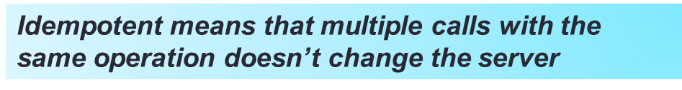
Request GET versus POST
Difference between GET and POST:
  GET request has no message body, so parameters are limited to what can fit into Query String.
    GET /advisor/selectBreadTaste.do?color=dark&taste=salty
  GET requests are idempotent
  GET is to retrieve data
  POST is to send data to be processed and stored
  POST has a body
  POST “more secure” since parameters not visible in browser bar
Notes:
HTTP 303 for redirect

Slide 12
Post/Redirect/Get (PRG) Pattern
POST-REDIRECT-GET, or the PRG pattern for short. The rules of the pattern are as follows:
Never show pages in response to POST
Always load pages using GET
Navigate from POST to GET using REDIRECT
Forward – if operation can be safely repeated upon a browser reload of the resulting web page [Use with GET].
Redirect - If operation performs an edit on the datastore, to avoid the possibility of inadvertently duplicating an edit to the database[Use with POST].
Notes:
See config for how to disable cache on back button with interceptor
<meta http-equiv="Cache-control" content="no-store">
<meta HTTP-EQUIV="Expires" content="-1">
http://www.metatags.org/meta_http_equiv_cache_control

Slide 13
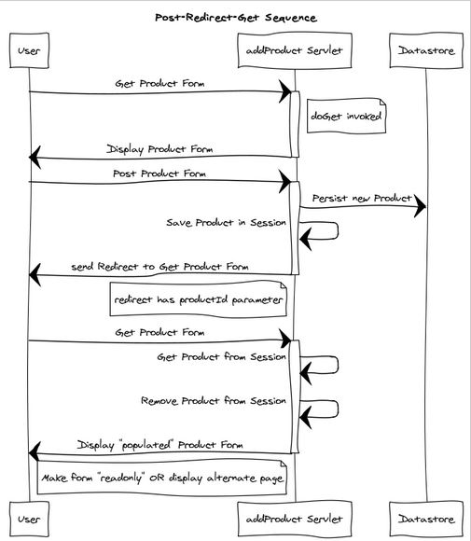

Slide 14
Spring MVC Forward & Redirect
Work Just like JSP Forward & Redirect
SYNTAX:
  return "forward:/demo";
  return "redirect:/demo";
WHERE:
  @RequestMapping(value="/demo" )
  public String getDemo (Model model) {}
EXTERNAL REDIRECT:
  return "redirect:http://www.mum.edu";
  See demo: ProductSessionExample - Redirect
REDIRECT NOTE: Attributes that are primitive & String types are automatically appended as query parameters.
Disable with:
<mvc:annotation-driven ignore-default-model-on-redirect="true" />

Slide 15
Flash Attributes
Efficient solution for the Post/Redirect/Get pattern.
Attributes are saved [in Session] temporarily before the redirect
Attributes are added to the Model of the target controller and are deleted [from Session] immediately.
@RequestMapping(value = "/product", method = RequestMethod.POST)
public String saveProduct(Product newProduct, Model model, RedirectAttributes redirectAttributes,
HttpServletRequest request) {
  redirectAttributes.addFlashAttribute(newProduct);
  // Returned as a parameter on GET URL
  redirectAttributes.addAttribute("name", "Kemosabe");
  return "redirect:/details";
}
String & primitive types are added to URL [e.g., GET]
redirectAttributes.addAttribute(newProduct.name);

Slide 16
CONTROLLER METHOD ARGUMENTS
Map Model/ModelMap
Command/form object [optional @ModelAttribute]
RedirectAttributes
SessionStatus
BindingResult Validation
@RequestParam
@RequestBody RESTful Services
@ResponseBody RESTful Services
@PathVariable Template
HttpServletRequest HttpServletResponse HttpSession
@RequestHeader
Notes:
@RequestHeader (value="Accept") - declares request header name …will return value from HTTP request to the controller method
@RequestMapping(value = "/hello.htm")
public String hello(@RequestHeader(value="Accept") String accept)
Accept = */* when hello method is called

Slide 17
Controller Method Return Types
ModelAndView object,
Model object, with the view name implicitly determined through a RequestToViewNameTranslator
Map object for exposing a model, the view name implicitly determined through a RequestToViewNameTranslator
String value interpreted as the logical view name, the model implicitly determined through command objects
void if the method handles the response itself (by writing the response content directly, declaring an argument of type ServletResponse / HttpServletResponse for that purpose) or if the view name is supposed to be implicitly determined through a RequestToViewNameTranslator
RequestToViewNameTranslator – basically uses the URL from the @RequestMapping

Slide 18
More Model, ModelMap, ModelAndView
Model is an interface while ModelMap is a class.
Model has method asMap to get actual map.
ModelMap is a class that is a custom[convenience] Map implementation that automatically generates a key for an object when an object is added to it.
ModelAndView is just a container for both a ModelMap and a view object. It allows a controller to return both as a single value.
Notes:
https://www.intertech.com/Blog/understanding-spring-mvc-model-and-session-attributes/
…adding elements directly to the HttpServletRequest (as request attributes) would seem to serve the same purpose. The reason to do this is obvious when taking a look at one of the requirements we have set for the MVC framework: It should be as view-agnostic as possible, which means we’d like to be able to incorporate view technologies not bound to the HttpServletRequest as well.

Slide 19
Main Point
Understanding the function and capability of the POST, Redirect and GET, leads to a combination that overcomes an inherent weakness in web applications.
The development of consciousness, increases awareness and eliminates the restrictions that cause inherent weakness.

